Slide 1


#AAUWStartSmart

Slide 2

4 STEPS TO SALARY NEGOTIATION
1. Know Your Value
2. Know Your Target Salary and Benefits
3. Know Your Strategy
4. Practice, Practice, Practice!
#AAUWStartSmart
Workbook Page 3
Notes:
Some of you might already be familiar with the core components of salary negotiation, but as I mentioned we’ve made a lot of changes in the structure and delivery of the content and have launched new curricula and materials. We’ve been busy retraining current facilitators and adding many new ones to our ranks.
The new workshops are shorter, streamlined, and more interactive, and they offer chances for experiential learning throughout the workshop.
Workshops are designed to be 2 hours long, and each one teaches participants our 4 steps to salary negotiation:
Knowing your value
Learning how to objectively identify target goals for salary and benefits
Understanding how to approach negotiation persuasively and strategically
And finally, the importance of practice out loud and often as you prepare
The programs are designed to empower women with the skills and confidence they need to successfully negotiate salary and benefits. By learning these critical steps to negotiation and practicing effective language, participants gain valuable skills they can use throughout their lives — well beyond their next negotiation.

Slide 3

The Gender Pay Gap and
How It Affects You
#AAUWStartSmart
Workbook Page 4

Slide 4

The gender pay gap is how we describe the inequality in what men and women are paid nationally.
Women working full-time are paid 80 cents for every dollar earned by a man.
#AAUWStartSmart
Workbook Page 4

Slide 5
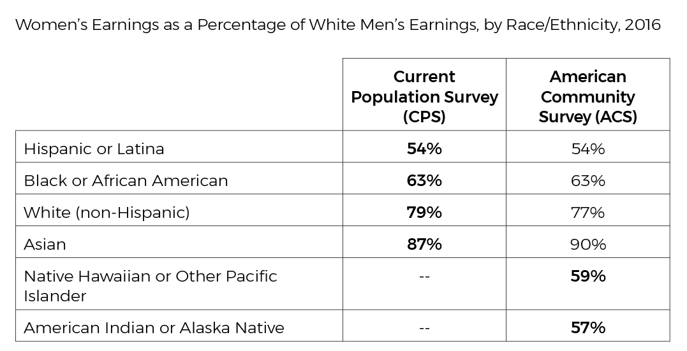
The Gender Pay Gap by Race
4
Note: Based on median annual earnings of full-time, year-round workers. The CPS includes workers 15 and older, and the ACS includes workers 16 and older. The CPS is the preferred data source for income estimates
but lacks sufficient sample size for reporting on smaller demographic groups, which is why percentages for two categories above are unavailable.
Workbook Page 5

Slide 6

What are the causes of the gender pay gap?
Women are
  Paid less for the same work
  Overrepresented in low-wage jobs and underrepresented in high-wage ones
  Well represented in undervalued fields such as health care, education, and public administration
  Discriminated against and face barriers that result in lower pay because they are often caregivers
#AAUWStartSmart
Workbook Page 5
Notes:
Sometimes, women and men makes choices that affect their salaries, and in turn, this affects the pay gap.
Men and women still tend to choose different majors in college and to work in different occupations after college.
Women also tend to work fewer hours, even when they work full time. (Full-time work is defined by the Bureau of Labor Statistics as 35 hours a week or more.)
Women are more likely to leave the workforce or work part time when they have young children.
Choices account for some of the differences in salaries, but they aren’t the whole story.
The 2012 AAUW report Graduating to a Pay Gap: The Earnings of Women and Men One Year after College Graduation examines this question. After accounting for the issues raised above as well as others, our study found that there was a 7 percent difference in the earnings of women and men one year after college graduation that was still unexplained.

Slide 7

Lifetime Losses
Based on today’s national pay gap, the National Women’s Law Center determined that women would lose $418,800 over the course of a 40-year career compared with white men.
African American women lose $840,040 over the course
of a 40-year career compared with white men.
Latinas lose $1,043,800 over the course of a 40-year career
compared with white men.
Workbook Page 7

Slide 8

What do you see as your biggest challenge in negotiating your salary and benefits?
Workbook Page 7

Slide 9
Negotiation Step 1:
KNOW YOUR VALUE
#AAUWStartSmart
Workbook Page 8
Notes:
The first step is “Know Your Value.”
Turn to your work sheets.
Think about the job you have or the one you seek. How do you connect your value — your background, qualifications, skills, experiences, and so on — back to the marketplace you are trying to get hired into?

Slide 10
Articulating Your Value
“As a result of my effort to do _____________, I have achieved _____________, which provided the following specific benefits to the company: _____________.”
Workbook Page 8

Slide 11

#AAUWStartSmart
Workbook Page 8

Slide 12

#AAUWStartSmart
Workbook Page 9-10

Slide 13
Negotiation Step 2:
KNOW YOUR TARGET SALARY
AND BENEFITS
#AAUWStartSmart
Workbook Page 11
Notes:
One of the most critical components of our workshops is the identification of a target salary and benefits.

Slide 14

6 Steps to Benchmarking
Your Salary and Benefits
Research and identify a comparable job title.
Find the salary range and establish your target salary.
Identify your target salary range.
Create a realistic budget.
5. Determine your resistance point.
6. Assess the value of benefits.
#AAUWStartSmart
Workbook Page 11

Slide 15
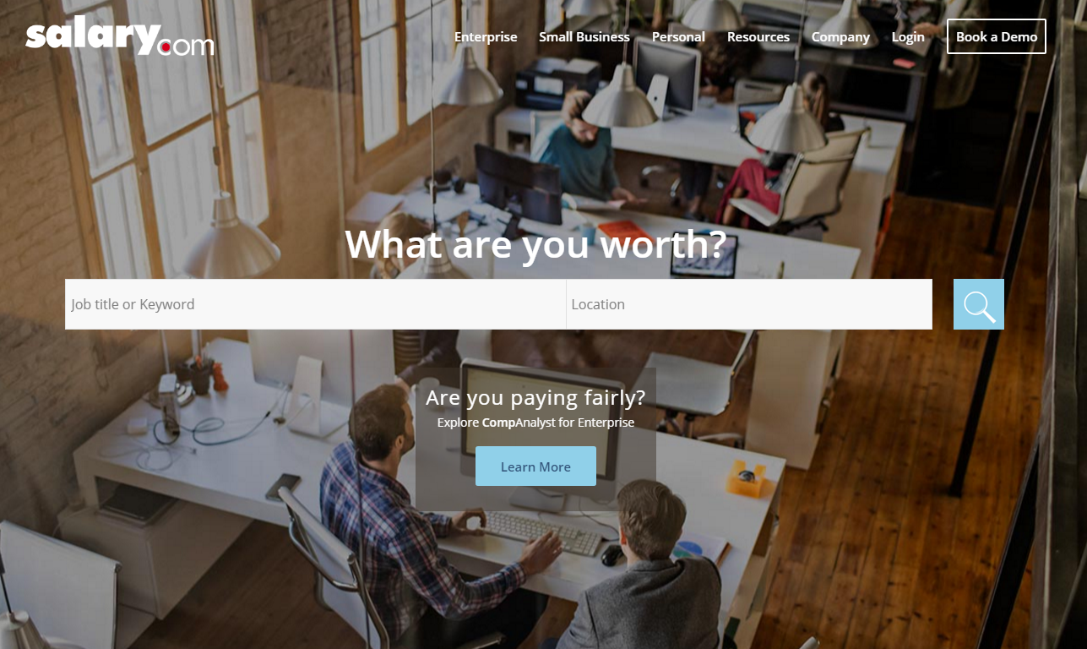
Input a job title or
keyword and location.
#AAUWStartSmart
Workbook Page 12

Slide 16

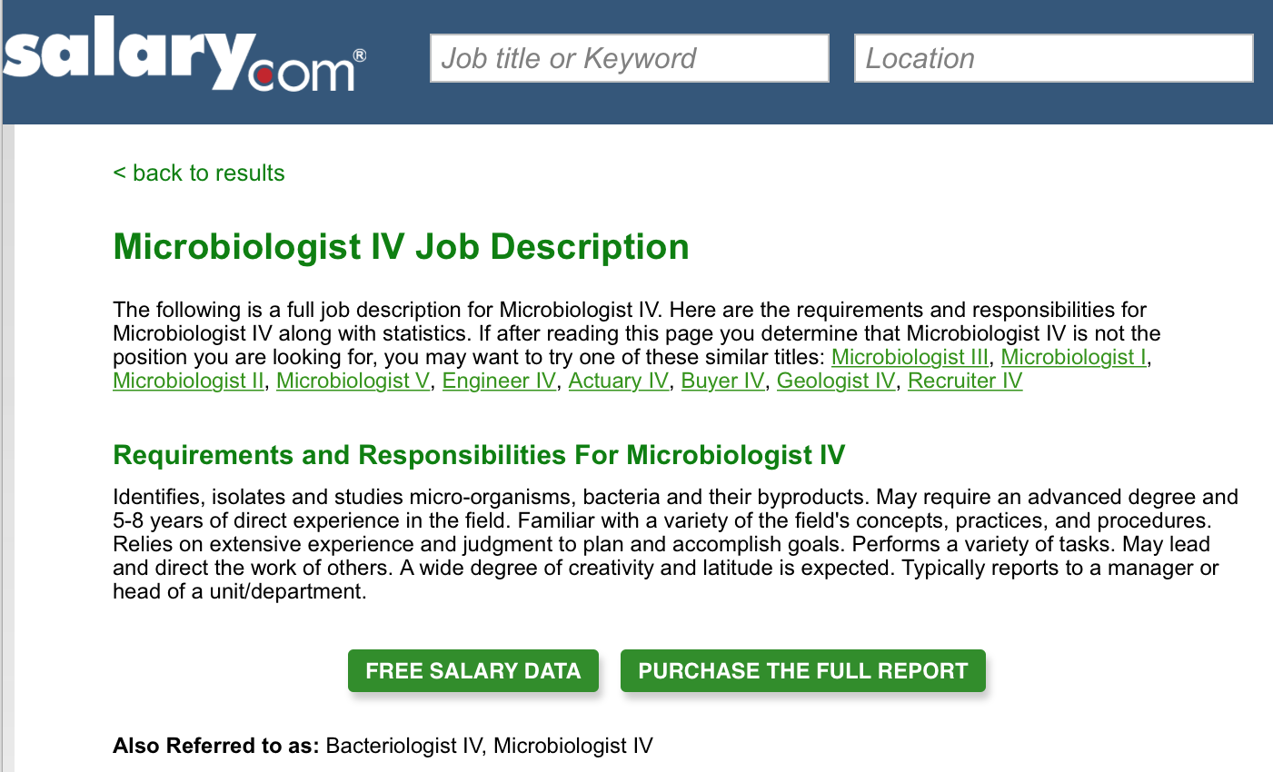

Slide 17
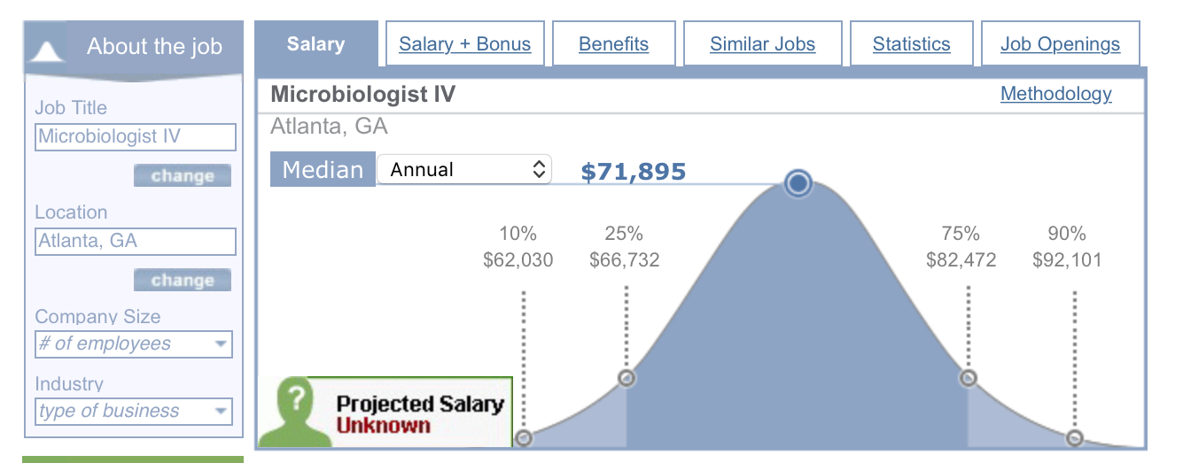
Notes:
Salary Mid-Point – Target Salary = 71, 895
Target Salary Range - $72 - $78K

Slide 18

Set a target salary and target salary range.
Workbook Page 12

Slide 19
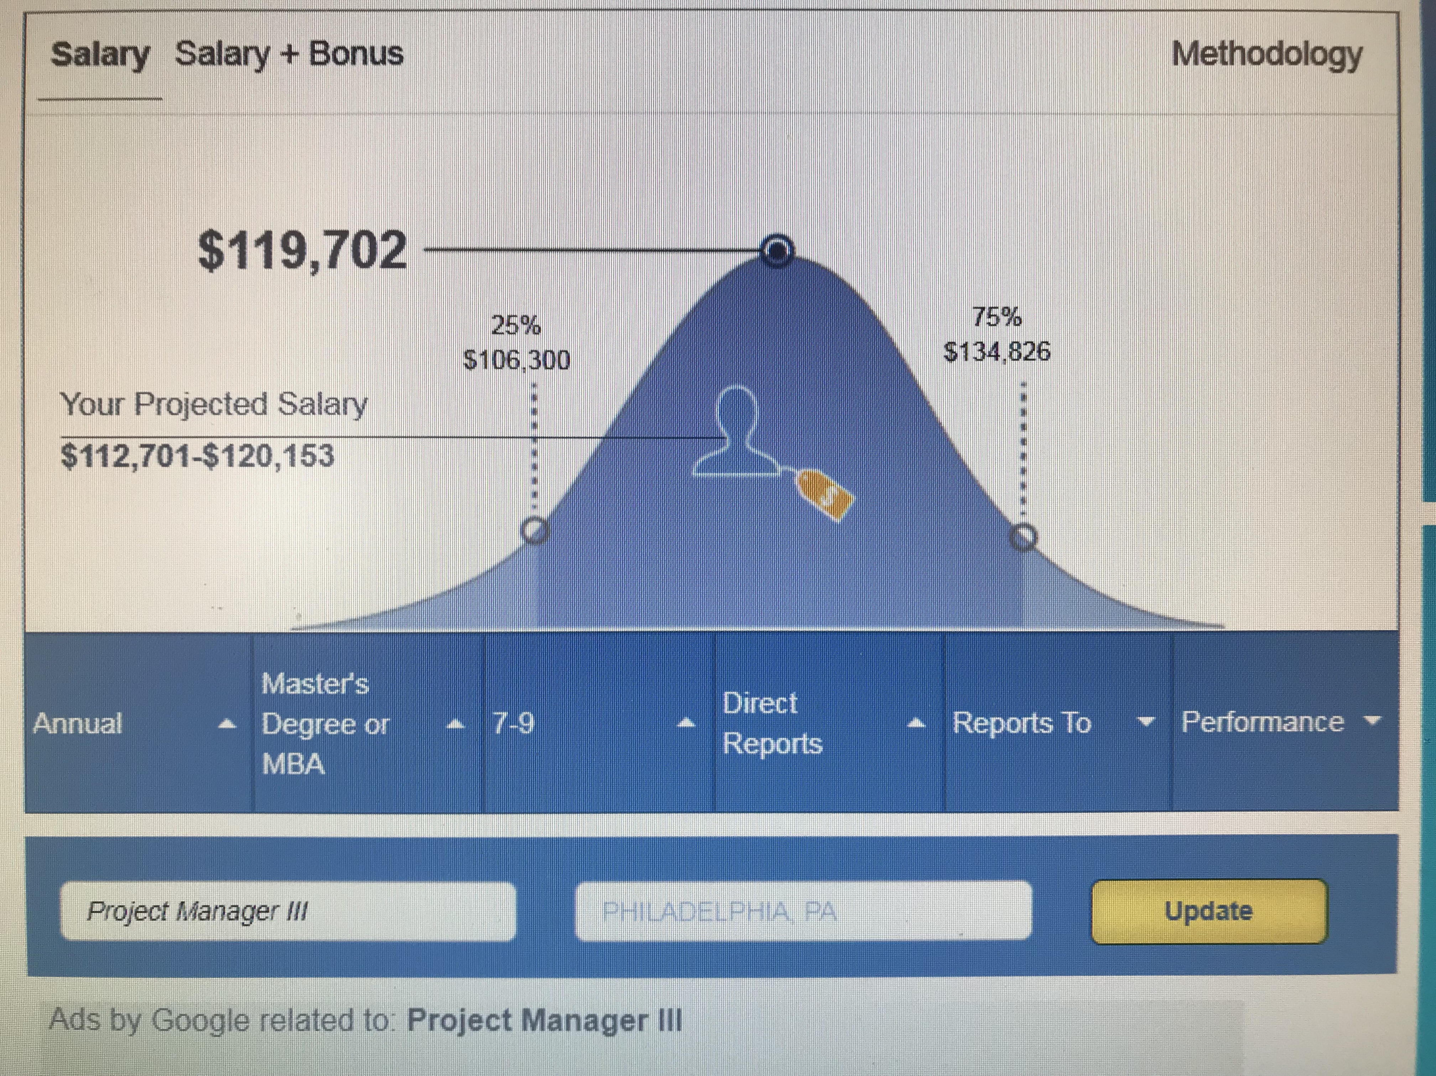
Project Manager | Philadelphia PA
Refer to “senior project manager” description

Slide 20
Establish a Target Salary Range
Start with your target salary and then
stretch upward.
Workbook Page 13

Slide 21

Create a Realistic Budget
#AAUWStartSmart
Workbook Page 13-15

Slide 22

Determine a resistance point.
Workbook Page 13

Slide 23

Consider the Benefits
Family and medical leave
Flex time
Health insurance
Life and disability insurance
Professional development
Retirement investment plans
Sick, personal, and parental leave
Tuition reimbursement
Vacation time
Moving expenses
Stock options
Title change
#AAUWStartSmart
Workbook Page 13

Slide 24
Negotiation Step 3:
KNOW YOUR STRATEGY
#AAUWStartSmart
Workbook Page 18
Notes:
Up to this point, we have discussed strategies and tools to be highly objective during negotiations. For the rest of this workshop, we are going to focus on ways to become highly strategic and highly persuasive.

Slide 25
Tips for Entering Your Negotiation
Bring your notes into your negotiation.
Remain positive and flexible.
Negotiation isn’t a battle; it’s a conversation.
Don’t get personal.
Anticipate your employer’s reactions and responses.
Remember, your employer has picked YOU. They want to make it work.
#AAUWStartSmart
Workbook Page 18

Slide 26
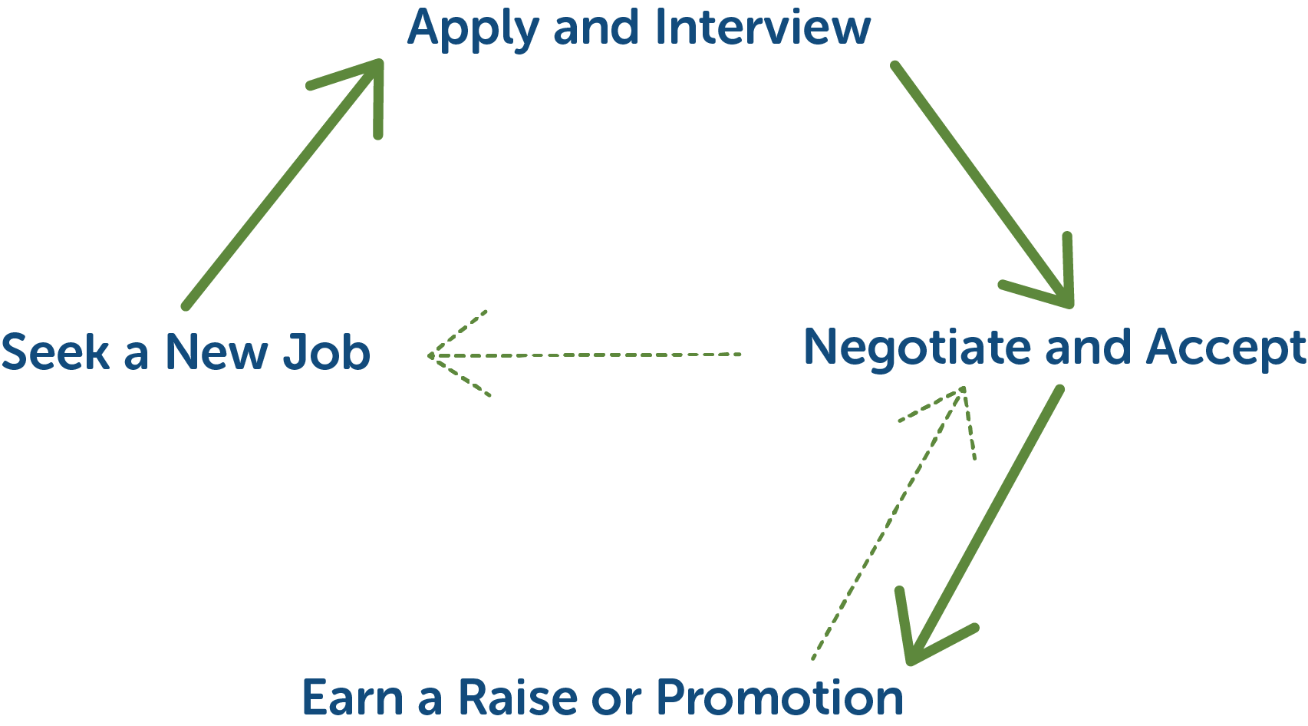
The entire life cycle looks like this:
Workbook Page 18

Slide 27

Can you please tell me your salary history?
What are your salary expectations?
I need to know what salary you want in order to make you an offer.
Workbook Page 18

Slide 28

You got the job!
Now what?
Workbook Page 19-20

Slide 29

#AAUWStartSmart
Workbook Page 20-22

Slide 30
Consider the Benefits
Family and medical leave
Flex time
Health insurance
Life and disability insurance
Professional development
Retirement investment plans
Sick, personal, and parental leave
Tuition reimbursement
Vacation time
Moving expenses
Stock options
Title change
#AAUWStartSmart
Workbook Page 22

Slide 31

#AAUWStartSmart
Workbook Page 22

Slide 32

Stereotypes and
the Double Bind
Workbook Page 22

Slide 33
Negotiation Step 4:
PRACTICE, PRACTICE,
PRACTICE!
#AAUWStartSmart
Workbook Page 23
Notes:
Let’s role-play for a few minutes to get some practice.
As I’ve been saying throughout this workshop, practice is an important step in preparing for salary negotiation. I’m going to give you instructions first, so listen carefully before you start moving.
We are going to do a role-play exercise of a negotiation between an employee and employer, and we are going to do it twice so that each of you gets to play the employee role and the employer role. Before we get started, I’m going to give you three minutes to prepare a negotiation strategy. Fill out the employee prep side of this worksheet. We want this role-play to be as realistic as possible, so we are going to let you choose what job you want to negotiate for when you are playing the employee. Then I’ll give further instructions. Employees, make sure you tell your partner what job you want to negotiate for and very briefly describe it.
Give them three minutes to fill out the worksheet, and then give them two to three additional minutes to find a partner and determine roles. If there are an odd number of participants, step in for anyone who is not matched up.
I’ll show the first set of employers a salary range that you are authorized to negotiate within for this position. Assume that this number is based on your organization’s budget and what you think the job is worth. Remember, you do not want to lowball your employee — good salaries retain good employees!
I’ll also be showing the first set of employees your target salary range. You can write it down on page 21. As you look at this range, assume that you have already been offered the job and have done your research. This includes picking a target salary in the range.
Remember, you want your employer to name a salary first. Once she does, you should use your workbook to respond. If you give a counteroffer, aim high but be realistic.

Slide 34


Role-Play Tips
Employers
Employees
Do pay your new hire a fair salary. Good pay attracts and keeps good employees.
Don’t give away the farm. You can’t pay what you can’t afford.
Do have a target salary in mind.
Do sell yourself and aim high (but be realistic).
Don’t share your desired
salary first. Instead, deflect
by letting the employer
know that you’d like to
better understand the
job responsibilities and
requirements.
Workbook Page 24-25

Slide 35
Role-Play Round 1
Employee Target Range
$112,700-120,153
Target Salary: Senior Project Manager
Workbook Page 24

Slide 36

#AAUWStartSmart

Slide 37
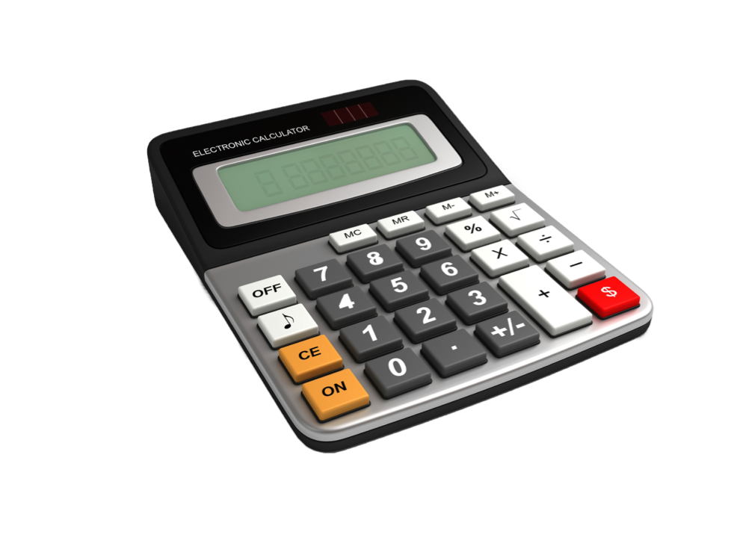
Role-Play Round 1
Employer Salary Range
$106,300–$110,000
Starting Offer
Maximum Budgeted
Workbook Page 25

Slide 38
Sample Starting Language
Employees: “Thank you for this opportunity to work for your company.”
Employers: “We’re happy to work with you. Before we discuss your start date, can you share with me your desired salary?”
Workbook Page 24-25

Slide 39
Role-Play Round 2
Employee Target Range
$119,702-134,826
Target Salary
Workbook Page 24

Slide 40
#AAUWStartSmart

Slide 41
Role-Play Round 2
Employer Salary Range
$125,000–$125,000
Starting Offer
Maximum Budgeted
Workbook Page 25

Slide 42
Sample Starting Language
Employees: “Thank you for this opportunity to work for your company.”
Employers: “We’re happy to work with you. Before we discuss your start date, can you share with me your desired salary?”
Workbook Page 24-25

Slide 43
4 STEPS TO SALARY NEGOTIATION
1. Know Your Value
2. Know Your Target Salary and Benefits
3. Know Your Strategy
4. Practice, Practice, Practice!
#AAUWStartSmart
Workbook Page 26
Notes:
Some of you might already be familiar with the core components of salary negotiation, but as I mentioned we’ve made a lot of changes in the structure and delivery of the content and have launched new curricula and materials. We’ve been busy retraining current facilitators and adding many new ones to our ranks.
The new workshops are shorter, streamlined, and more interactive, and they offer chances for experiential learning throughout the workshop.
Workshops are designed to be 2 hours long, and each one teaches participants our 4 steps to salary negotiation:
Knowing your value
Learning how to objectively identify target goals for salary and benefits
Understanding how to approach negotiation persuasively and strategically
And finally, the importance of practice out loud and often as you prepare
The programs are designed to empower women with the skills and confidence they need to successfully negotiate salary and benefits. By learning these critical steps to negotiation and practicing effective language, participants gain valuable skills they can use throughout their lives — well beyond their next negotiation.

Slide 44


What was an aha moment for you during this workshop?
What is one thing you will do to practice what you learned?
Workbook Page 26

Slide 45
Thank you and good luck.
Please submit your surveys to your facilitator.
Take action by becoming a Two-Minute Activist
when you text “Start Smart” to 21333.
By providing my cell phone number, I understand that AAUW may send recurring text messages to my cell phone. AAUW will never charge for alerts,
but carrier message and data rates may apply. Text STOP to 21333 to stop receiving messages.

